Slide 1
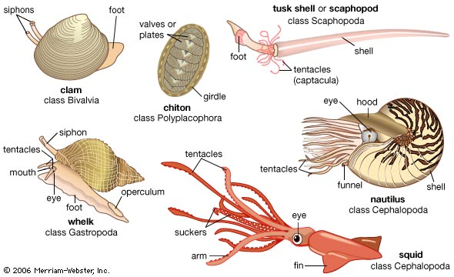
Mollusks (Mollusca)

Slide 2
Phylum Mollusca
Polyplacophora
Gastropoda
Bivalvia
Scaphopoda
Cephalopoda

Slide 3
Molluscs
Have adapted to a wide variety of habitats
Terrestrial, marine, benthic, and accomplished swimmers.

Slide 4
Major classes of Phylum Mollusca
Polyplacophore (e.g. Chitons) - shell with eight plates, foot used for locomotion, radula, no head
Gastropoda (e.g. snails, slugs) - asymmetrical body, coiled shell (if one is present), foot for locomotion, radula
Bivalvia (e.g. clams, mussels, scallops, oysters) - flattened shell with two valves, no head, paired gills, no radula, suspension feeders, mantle forms siphons
Cephalopoda (e.g. squids, octopuses, cuttlefish, chambered nautiluses) - head surrounded by grasping tentacles, have suckers, shell external, internal or absent, mouth w/ or w/o radula, locomotion by jet propulsion by siphon
Kel Chan

Slide 5
Taxonomic Summary
Phylum Mollusca
Class Polyplacophora
Class Gastropoda
Subclass Prosobranchia
Subclass Opisthobranchia
Class Bivalvia
Class Scaphopoda
Class Cephalopoda

Slide 7
The Foot

Slide 8
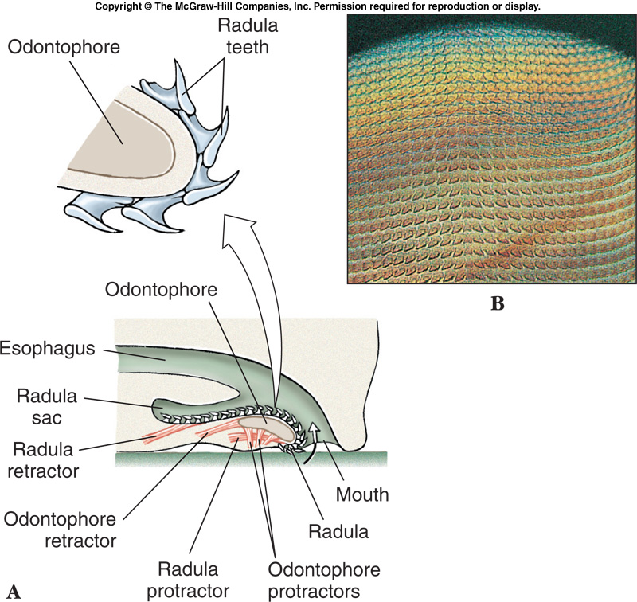
Radula

Slide 9
The Mantle
The mantle is the body wall that enclose the body cavity

Slide 10
The Mantle Cavity
Houses the viscera and comb-like molluscan gills
Ctenidia are respiratory in function and can collect food particles
Mantle cavity also is the site for reproductive, excretory, and digestive systems

Slide 11
Ingestion and Digestion
Radula is used to scrape algae from the rocks
Mouth is anterior and anus is posterior; linear digestive tract

Slide 12
Reproduction
Reproduction
Sexes are separate with fertilization occurring in the water column
Trochophore larvae
Free swimming which settles and metamorphoses into an adult

Slide 13
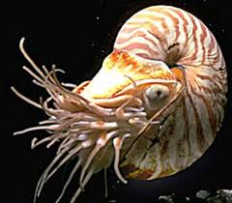
Nautilus

Slide 14
Class Polyplacophora
Defining characteristics
Shell forms as a series of 7 to 8 separate plates
Chitons

Slide 15
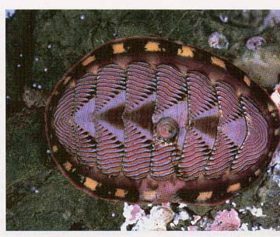
Chitons
Structure:
-oval-shaped body, not segmented
-shell with 8 dorsal plates, segmented
Food:
-uses it’s radula to cut and ingest algae
Marine; usually found clinging to rocks.
Its foot acts as a suction cup to grip the rock and creep along it.
(http://www.bethel.edu/~johgre/bio114d/images/higher%20inverts/nChiton.jpg)
Sheridan Edwards

Slide 16
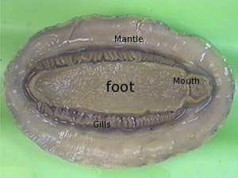
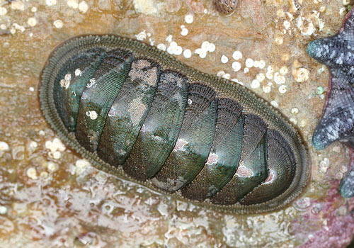
CHITON

Slide 17
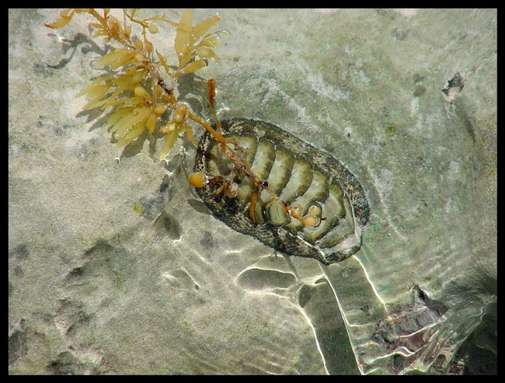
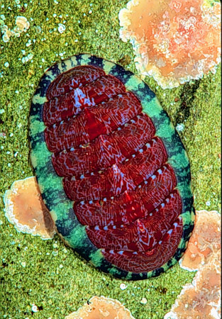
Chitons

Slide 18
Cephalopods
Food
Active Predators: tentacles grasp prey and inject poison
Structure
Modified Foot: foot becomes muscular excurrent siphon, and parts of foot and head
Evolutionarily Advanced: Only mollusks with a closed circulatory system, and have well-developed sensory organs and brains
Examples
Squid
Chambered Nautilus
Internal Shell: mantle covers the visceral mass, but shell is greatly reduced or missing. Chambered nautiluses are the only cephalopods with an external shell.
Ammonites
Octopus
thought to be the link between shelled cephalopods (chambered nautilus) and shell-less cephalopods (squid, octopus).
They were probably shelled mollusks that took up an active lifestyle and lost their shell through evolution.
http://i.ehow.com/images/GlobalPhoto/Articles/2181866/squid-main_Full.jpg
http://img3.travelblog.org/Photos/1/195834/f/1458234-Coconut-Octopus-0.jpg
http://hoopermuseum.earthsci.carleton.ca/saleem/Images/Ammonites.jpg
Olivia Petrocco
http://www.manandmollusc.net/advanced_introduction/MainPage/Nautilus.gif

Slide 19
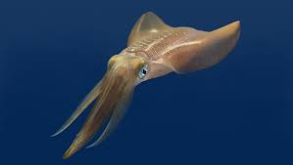
Squid

Slide 20
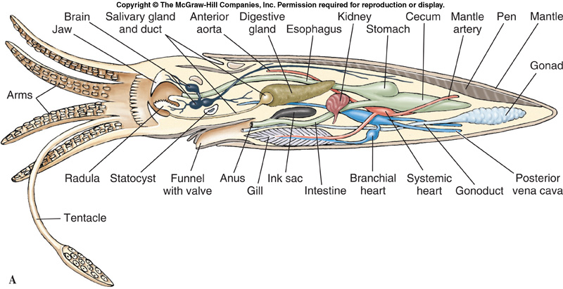
Squid Dissection

Slide 21
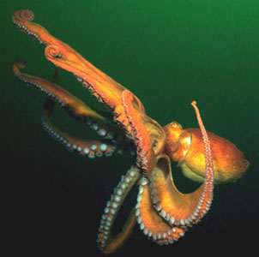
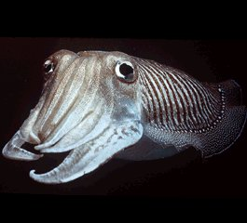
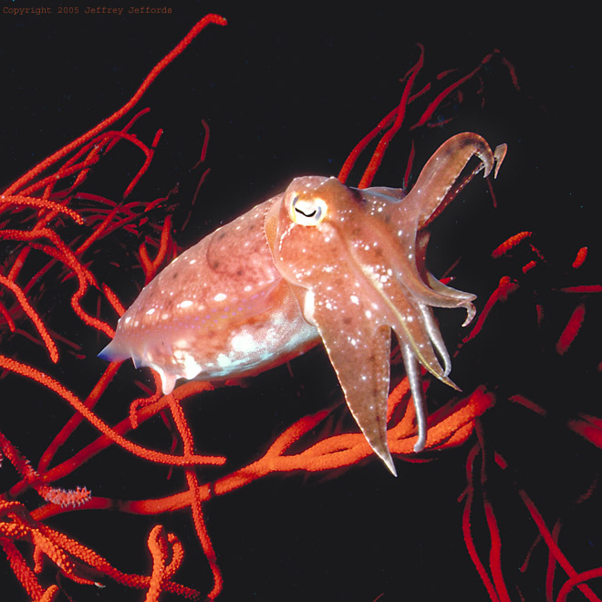

Slide 22
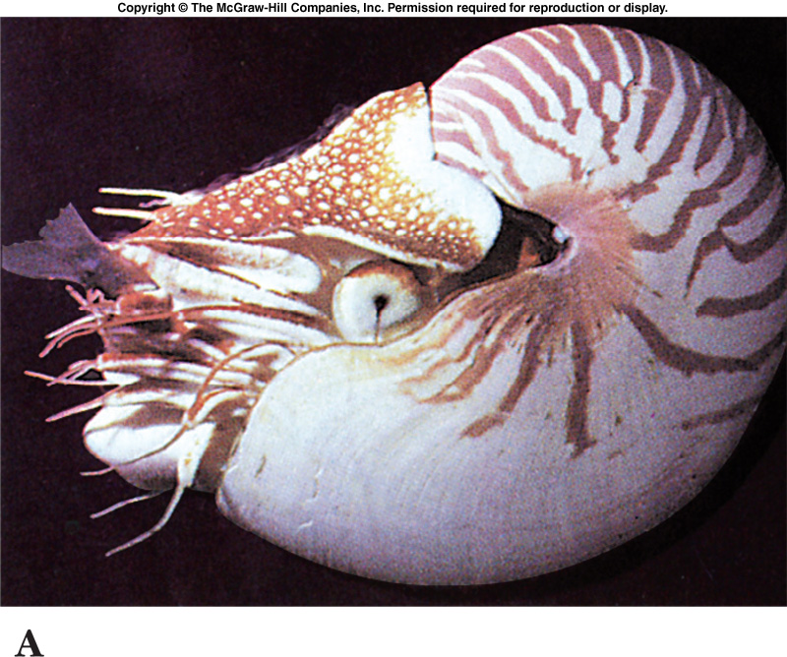
Chambered Nautilus

Slide 23
Octopus

Slide 24
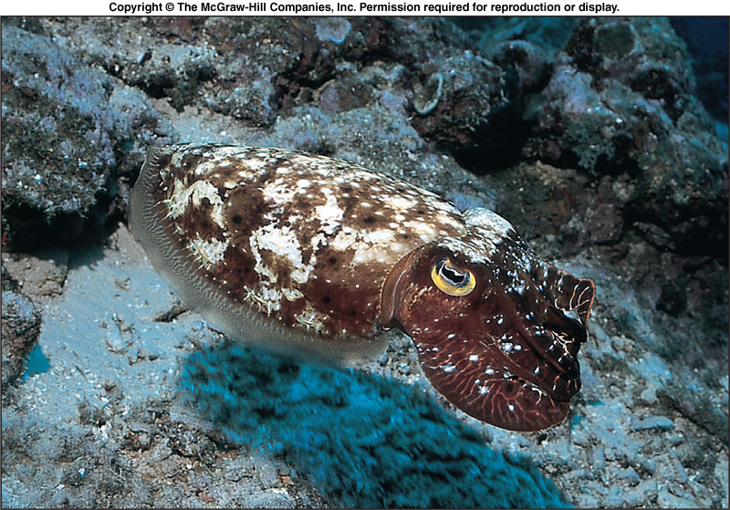
Cuttlefish

Slide 26
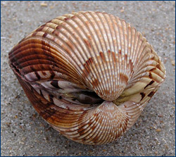
Bi-Valve

Slide 27
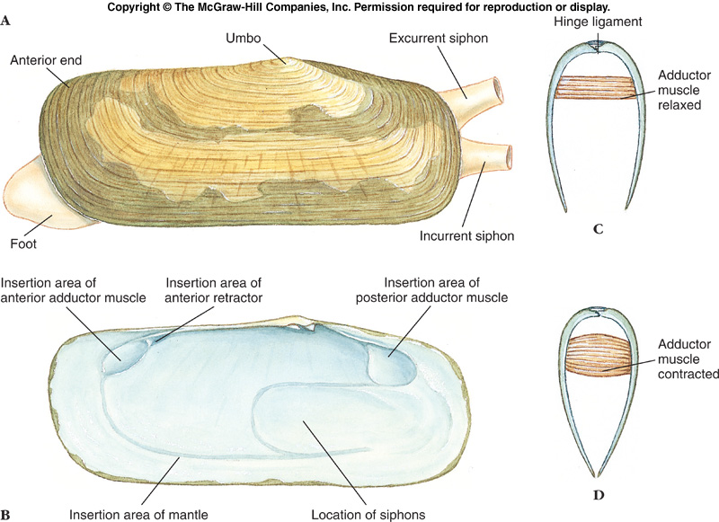

Slide 28
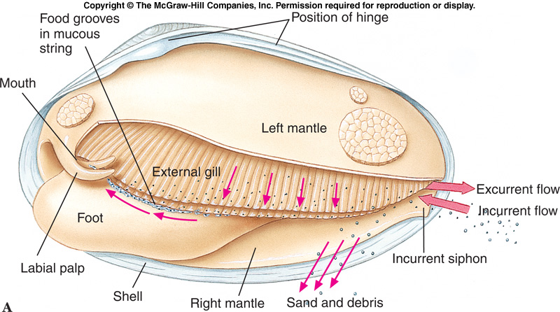
Figure 16.31a

Slide 29
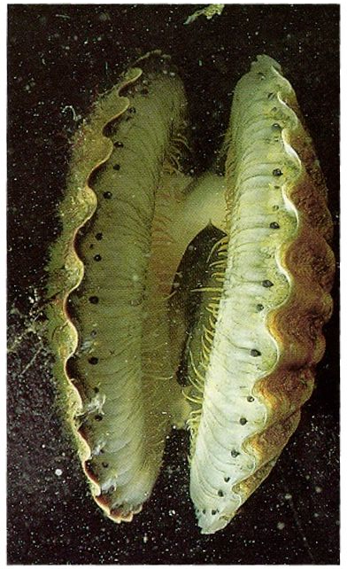
Bivalves
Examples
Clams
Structure
Shell divided into two halves
Halves hinged at mid-dorsal line
Oysters
Mussels
Scallops
Abductor muscles draw shell together to protect soft body
Food
Suspension feeders, and most live sedentary lives
Trap food particles in mucus that coats the gills then cilia move particles to the mouth
No radula
Mantle cavity used for feeding and gas exchange
Water enters the mantle cavity through incurrent siphon, passes over gills and leaves through excurrent siphon
http://www.geocities.com/ymike2002/images/BIVALVE.jpg
Olivia Petrocco

Slide 30
Body enclosed in mantle
shell has two lateral valves with dorsal hinge
Umbo – oldest part of shell
Head greatly reduced
No radula
No eyes, a few species with eyes on mantle margin
foot usually wedge-shaped

Slide 32
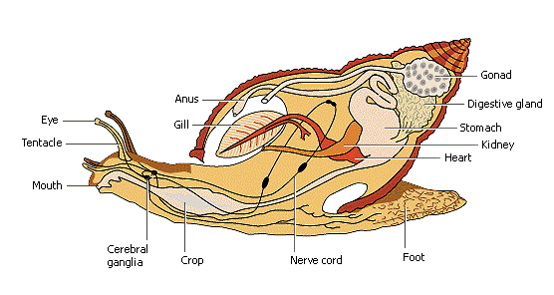
Gastropods
Structure: -torsion: in embryonic development, the visceral mass rotates 180 degrees
-differs from shell formation -asymmetrical body usually with a coiled shell
Food: -use radula to graze on algae or plants
-predators with radula modified to boring holes in shells or tearing apart prey
Terrestrial snails lack gills and use the lining of the mantle cavity as lungs.
(http://images.encarta.msn.com/xrefmedia/aencmed/targets/illus/ilt/T629043A.gif)
Sheridan Edwards
Notes:
(http://images.encarta.msn.com/xrefmedia/aencmed/targets/illus/ilt/T629043A.gif)

Slide 33
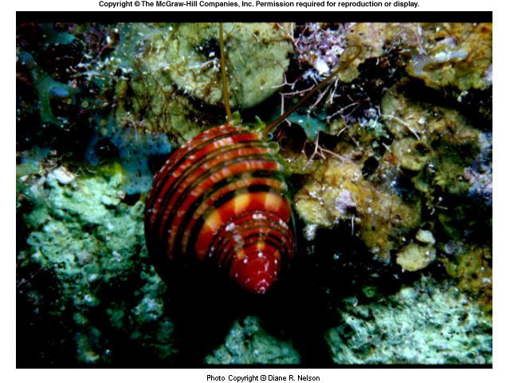
0057.jpg
Notes:
0057.jpg

Slide 34
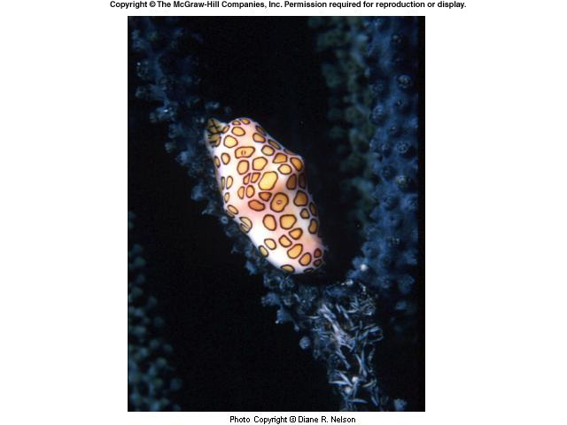
0060.jpg
Notes:
0060.jpg

Slide 35
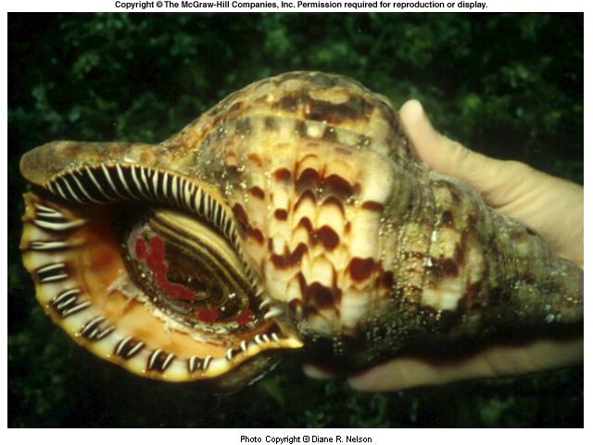
0063.jpg
Notes:
0063.jpg

Slide 37
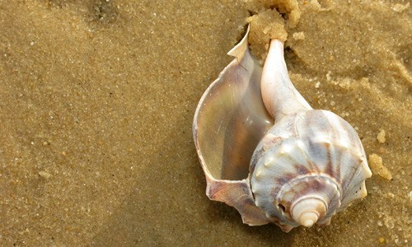
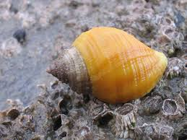
GASTROPODS
Snails
Whelks
Slugs

Slide 38
ESCARGOT

Slide 39
