Slide 1
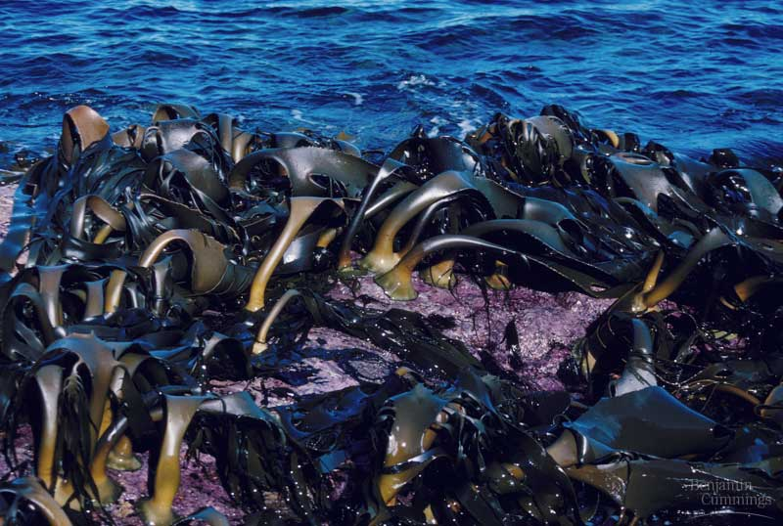
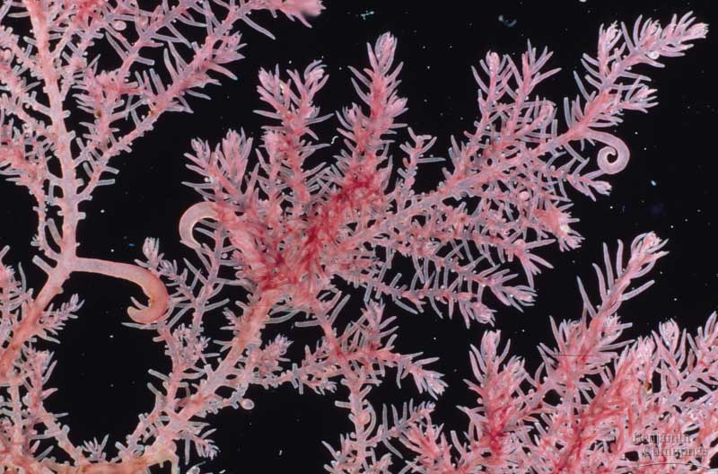
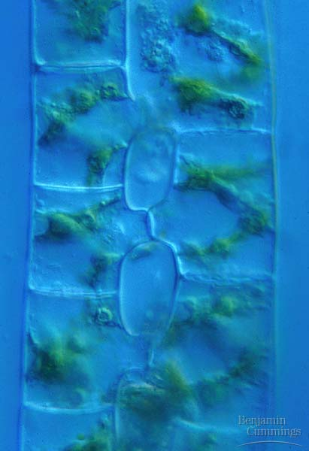
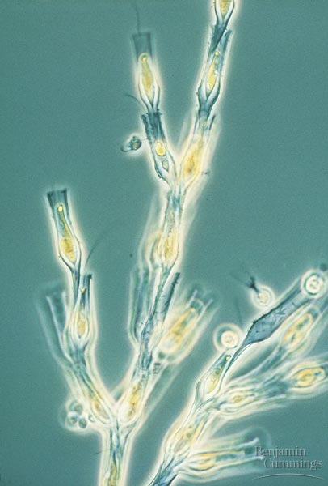
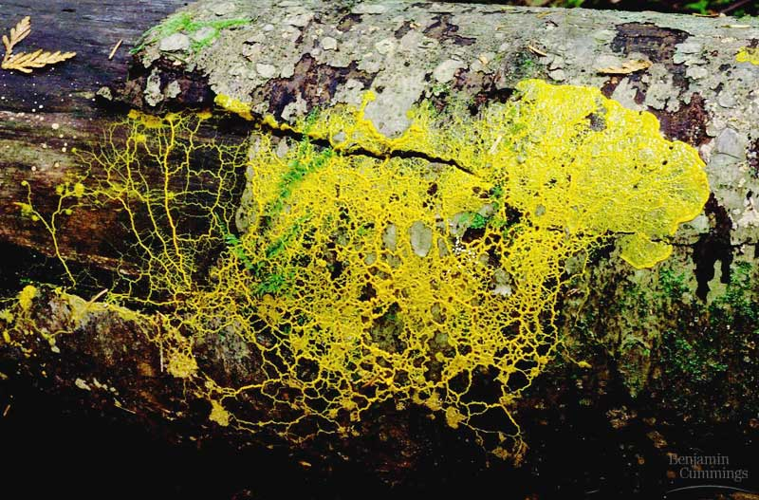
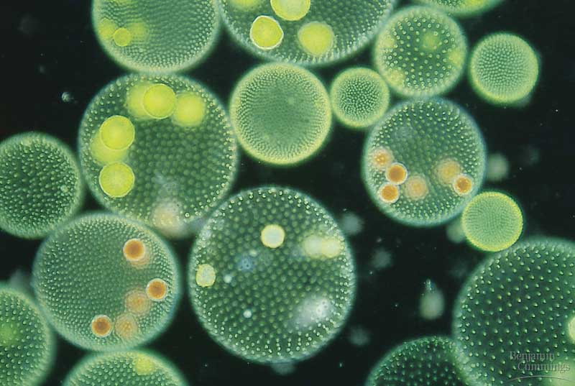
Algae
An Overview

Slide 2
Characteristics
Range in size from microscopic to single celled organisms to large seaweed
Autotrophic
Aquatic and have flagella at some point in life
Often contain pyrenoids, organelles that synthesis and store starch

Slide 3
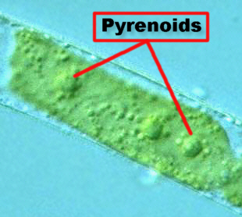
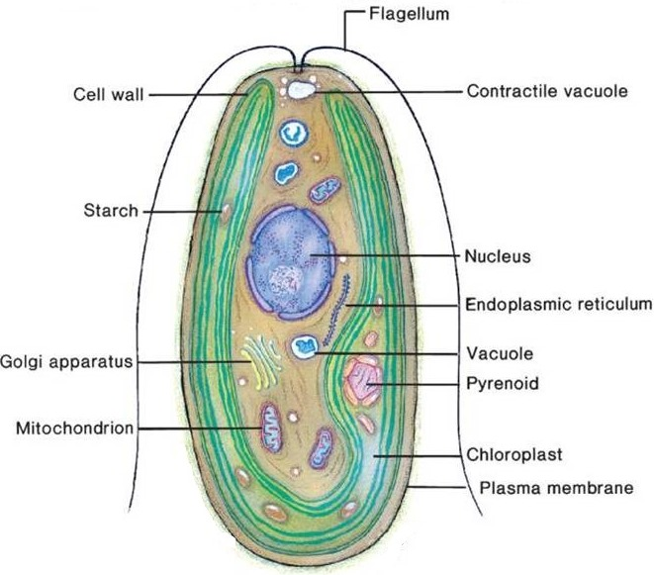
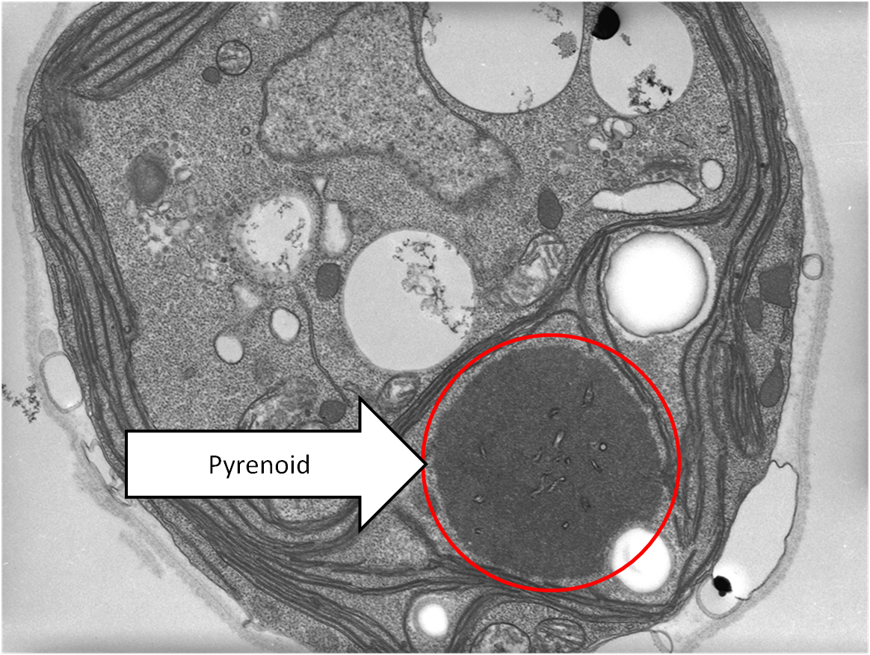

Slide 4
STRUCTURE
Four types of algae
Unicellular
Colonial
Filamentous
Multicellular

Slide 5
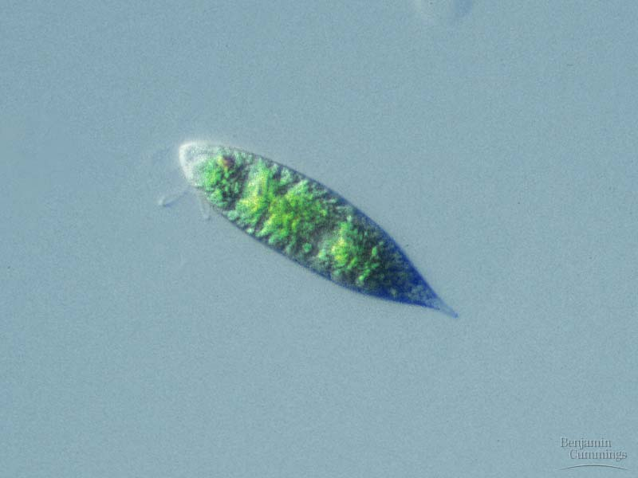
Unicellular

Slide 6
Colonial

Slide 7
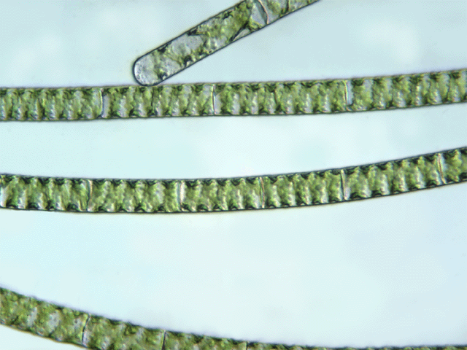
Filamentous

Slide 8
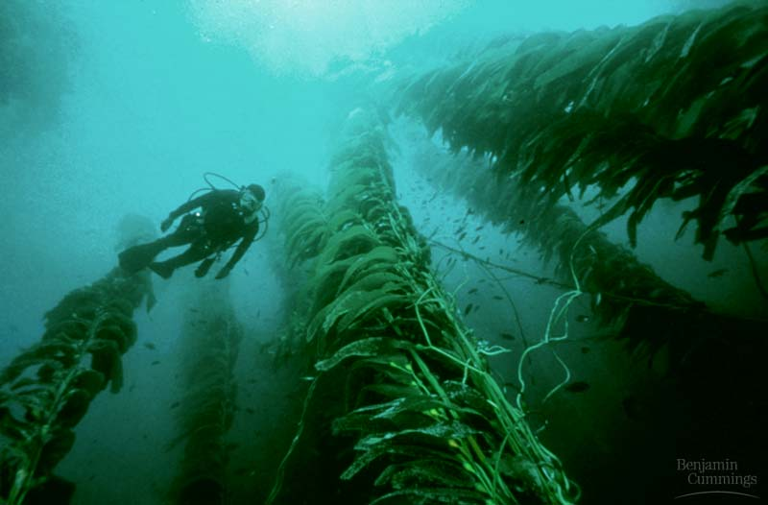
Multicellular

Slide 9
IDENTIFY THE TYPE OF ALGAE

Slide 10
3 DIFFERENT SEAWEED BASED ON COLOR

Slide 11
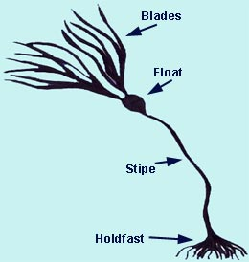
Seaweed Anatomy

Slide 12
Phylum Chlorophyta
Green algae
7000 diverse species
Biologist reason that green algae give rise to land plants.
Both green algae and land plants have chlorophyll A and B as well as carotenoids and store food as starch
Both have walls made of cellulose

Slide 13
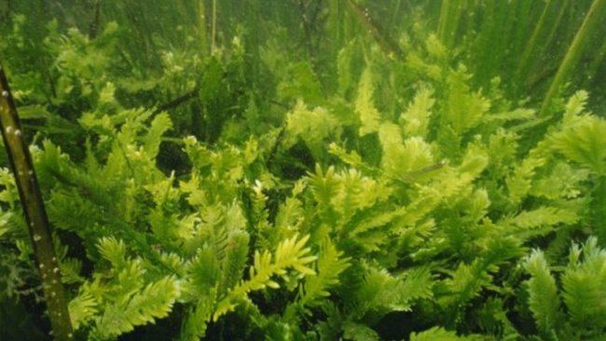

Slide 14
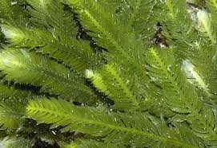

Slide 15
Phylum Rhodophyta
4000 species of RED Algae
Most are marine
Smaller than brown algae and are often found at a depth of 200 meters.
Contain chlorophyll A and C as well as phycobilins which are important in absorbing light that can penetrate deep into the water
Have cells coated in carrageenan which is used in cosmetics, gelatin capsules and some cheeses

Slide 16
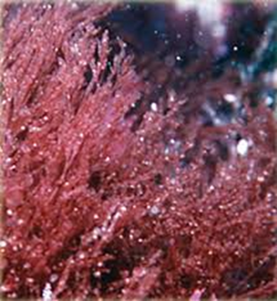

Slide 17
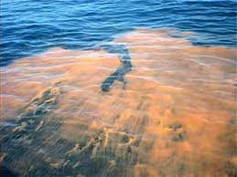

Slide 18
Phylum Phaeophyta
1500 species of Brown algae
Mostly marine and include seaweed and kelp
All are multicellular and large (often reaching lengths of 147 feet)
Individual alga may grow to a length of 100m with a holdfast, stipe and blade
Used in cosmetics and most ice creams

Slide 19
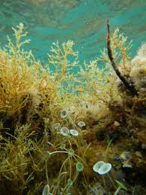

Slide 20
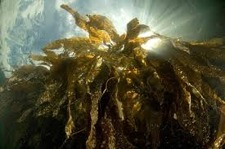

Slide 21
