Slide 1
Development of Continental Drift
Frank Taylor (1910)
Alfred Wegener (1912) Die Entstehung Der Kontinente Und Ozeane

Slide 2
Plate Tectonics
Continental Drift
Evidence of Plate Tectonics
Earth’s Structure
Plate Boundaries
Hot Spots

Slide 3
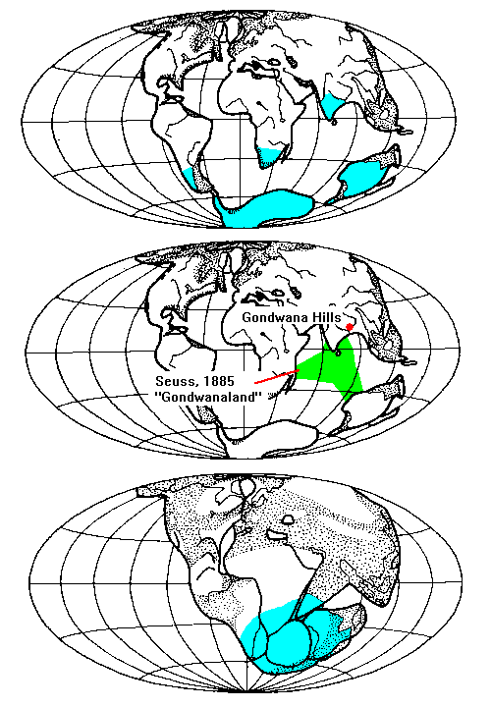
The Permian Ice Age Problem

Slide 4
Confirmation of Continental Drift
World War II technology
International Geophysical Year (IGY) 1957-58
Worldwide Standardized Seismic Network 1963-

Slide 5
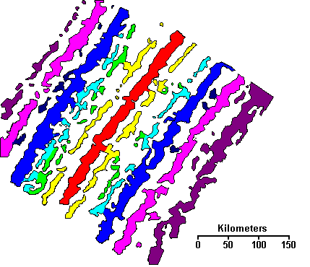
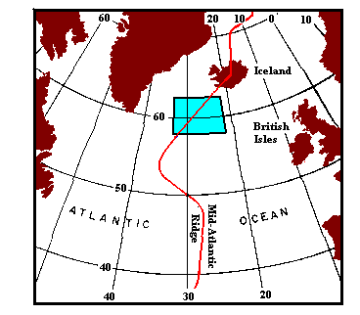
Discovery of Sea-Floor Spreading

Slide 6
Sea-Floor Spreading

Slide 7
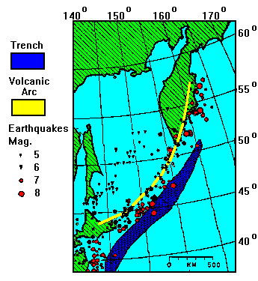
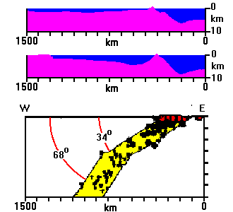
Where Does Ocean Crust Go?
Hugo Benioff, 1954

Slide 8
Benioff’s Interpretation Updated

Slide 9
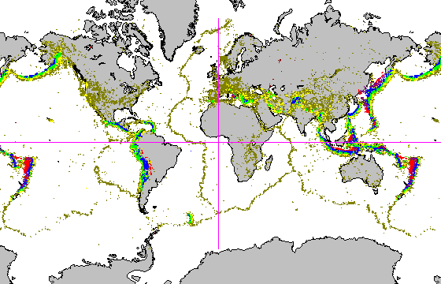
Worldwide Standardized Seismic Network

Slide 10
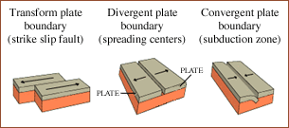
3 types of plate boundaries

Slide 11
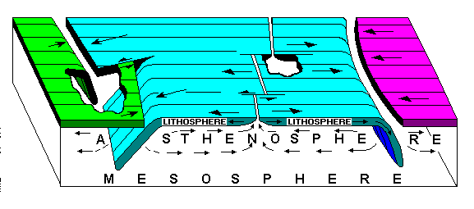
The Plate Tectonics Model

Slide 12
The Plate Tectonics Model

Slide 13
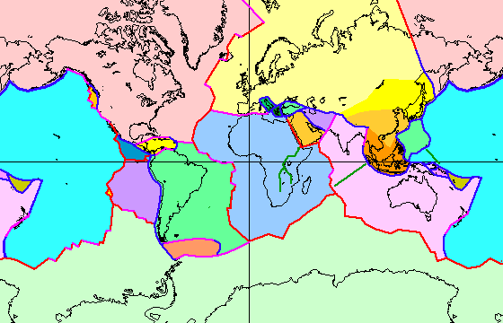
The Earth’s Plates

Slide 14
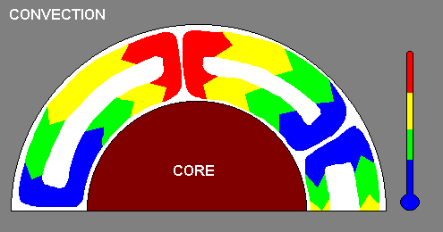
What Drives It: Convection

Slide 15
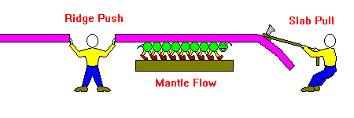
How Plates Move

Slide 16
Reconstructing Plate Movements

Slide 17
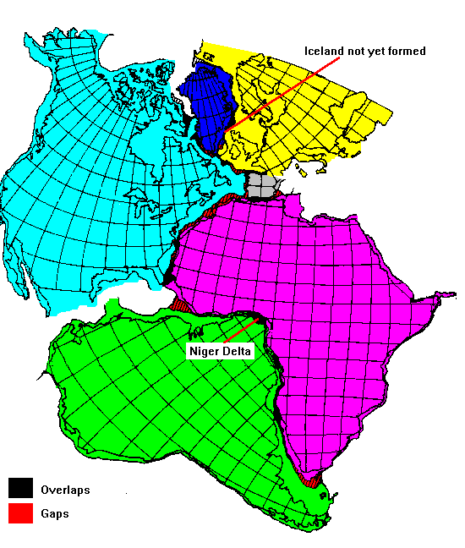
Fit of Continents Across the Atlantic

Slide 18
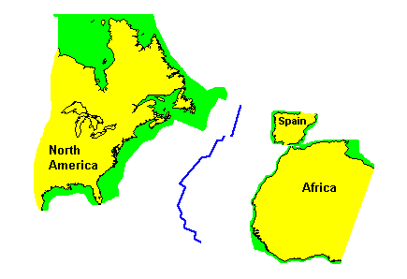
Atlantic 65 m.y. ago

Slide 19
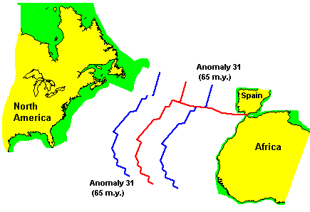
Present Day Atlantic

Slide 20
Geology of Plate Margins

Slide 21
Plate Boundaries
Divergent
Can create volcanoes, earthquakes, and mountains
Examples: Mid-Atlantic ridge, East Pacific Rise
Convergent
Can create volcanoes (continental and island arc), earthquakes, and mountains
Examples: Juan De Fuca Plate and North America Plate
Transform
Can create strong shallow earthquakes and folded mountains
Examples: San Andreas Fault

Slide 22
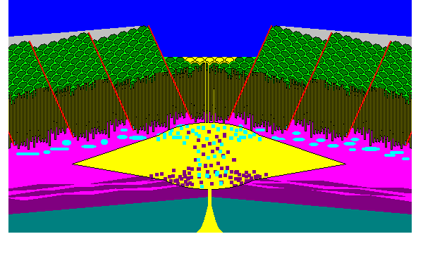
Anatomy of a Mid-Ocean Ridge

Slide 23
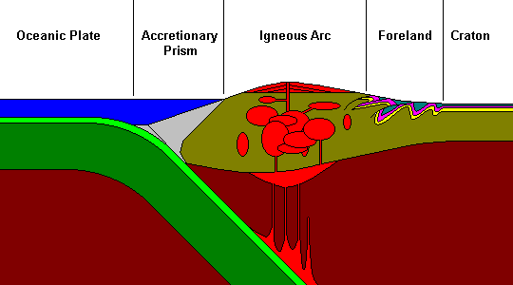
A Subduction Zone

Slide 24
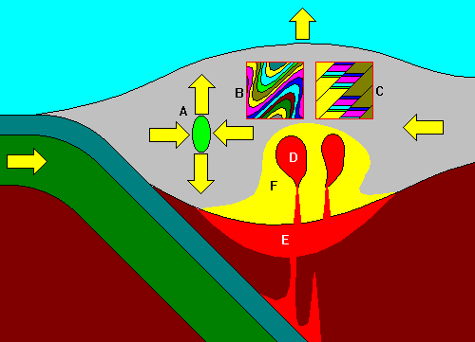
Why Mountains are High

Slide 25
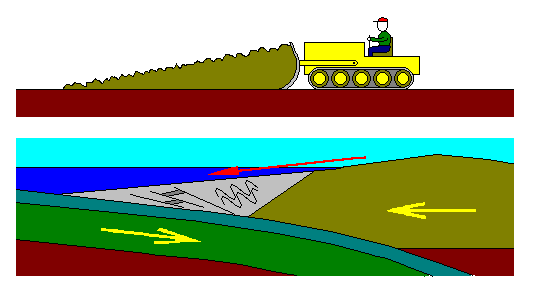
Where the Plates Meet

Slide 26
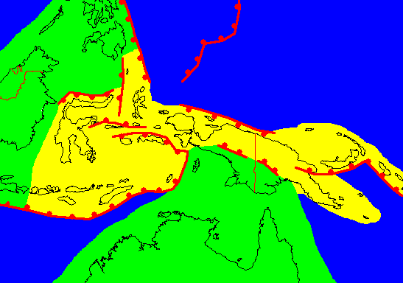
Terrane Accretion

Slide 27
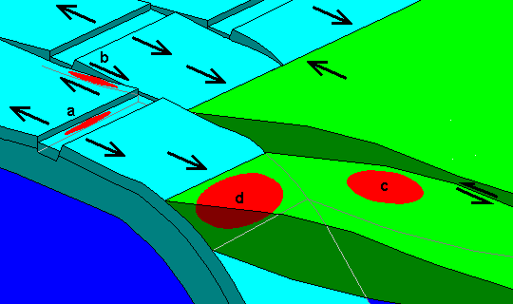
Plate Boundaries and Earthquakes

Slide 28
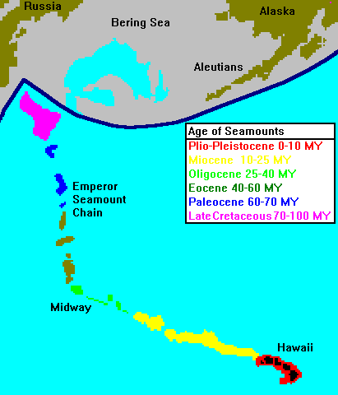
Hot Spots

Slide 29
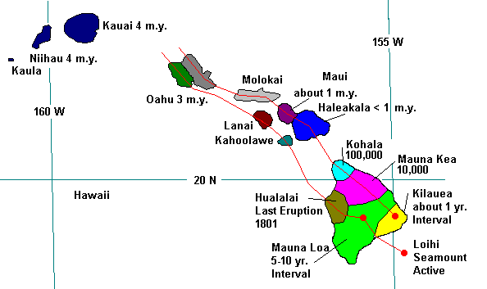
Hot Spots: Hawaii

Slide 30
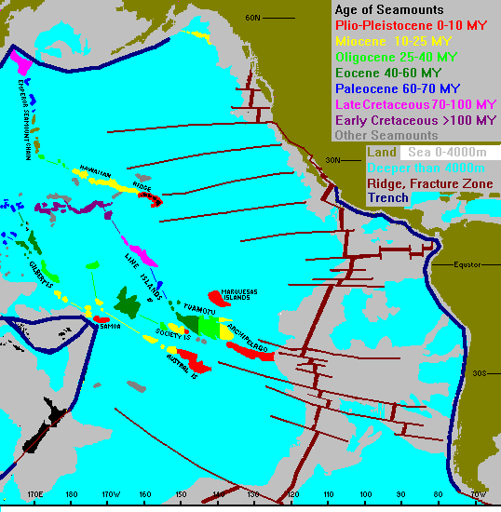
Pacific Hot Spot Tracks

