Slide 1
Journal
Vocabulary | Image
Definition | Sentence

Slide 2
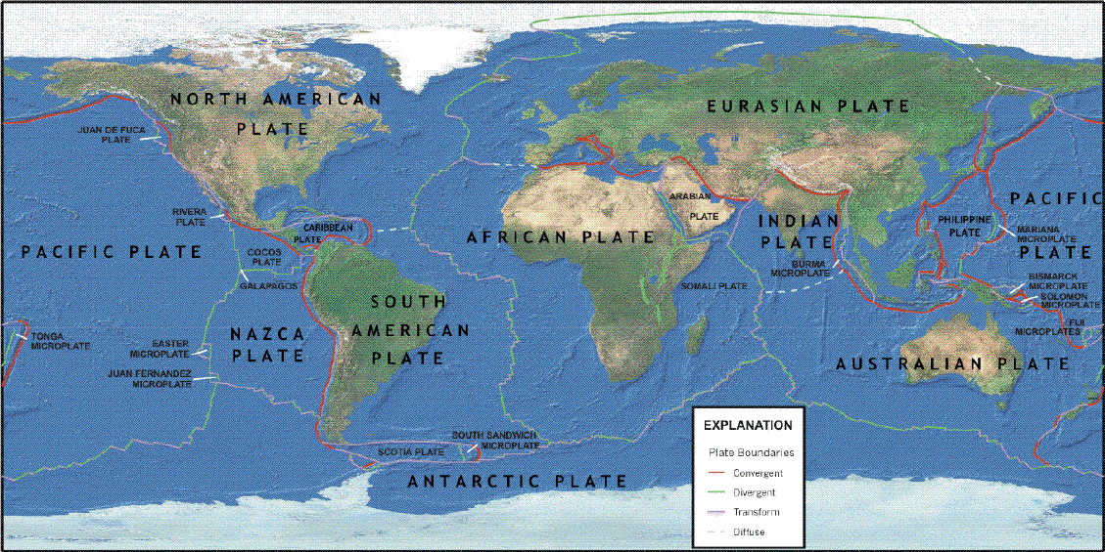
Vocabulary
Lithosphere
The outer shell of the Earth, lying above the asthenosphere and comprising the crust and upper mantle. | The lithosphere is broken into giant plates that fit around the globe like puzzle pieces.

Slide 3
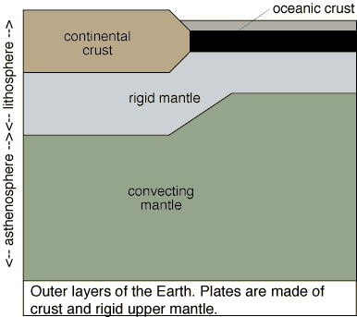
Asthenosphere
The layer of the mantle that lies directly below the lithosphere - is ductile and can be pushed and deformed like silly putty in response to the warmth of the Earth. | These puzzle pieces move a little bit each year as they slide on top of a somewhat fluid part of the mantle called the asthenosphere

Slide 4
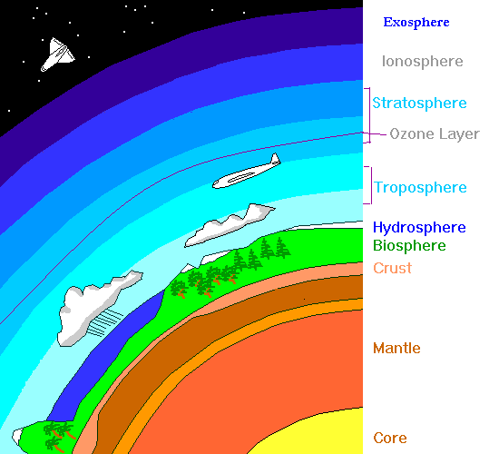
Vertical profile of the earth activity

Slide 5
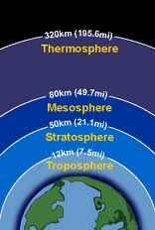
Layers of the atmosphere activity

Slide 6
Earth’s atmosphere is unique
Protection from UV
Water
Make up different
  Greenhouse Gases
    CO₂
    H₂O

Slide 7
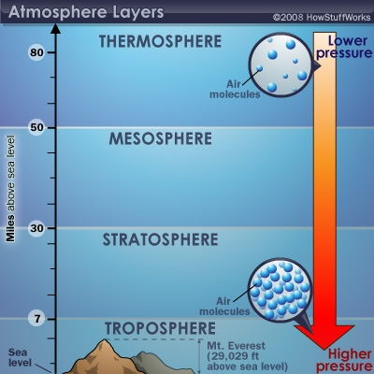

Slide 8
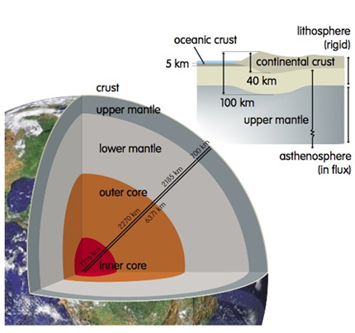

Slide 12
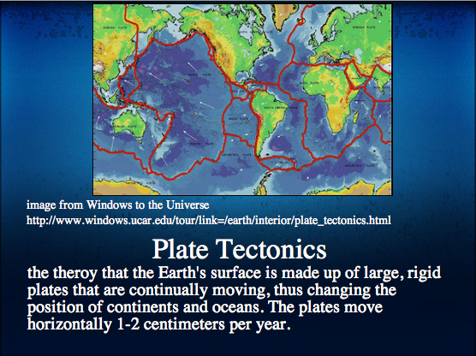

Slide 13
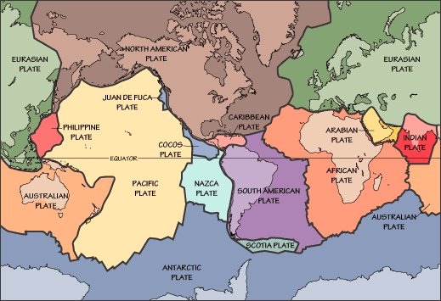

Slide 14
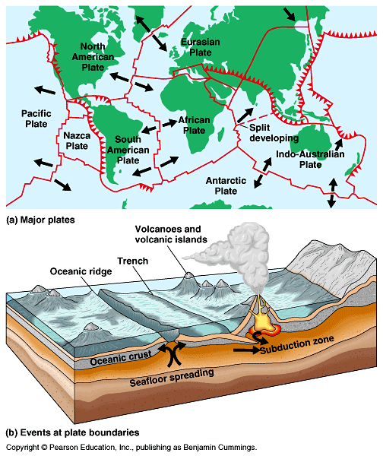

Slide 15
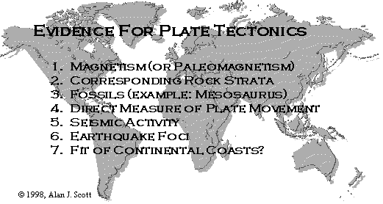

Slide 16
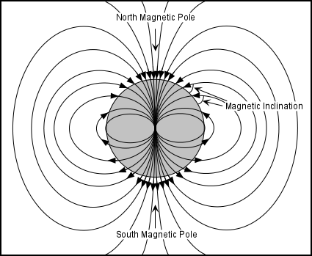
Magnitism

Slide 17
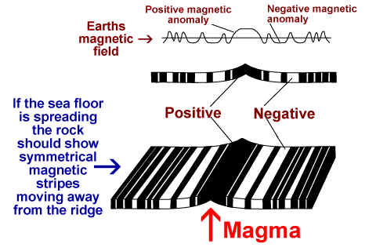

Slide 18
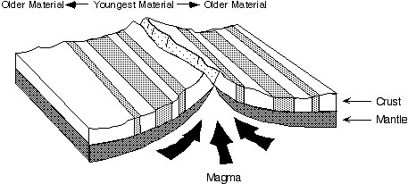
Sea Floor Spreading

Slide 19
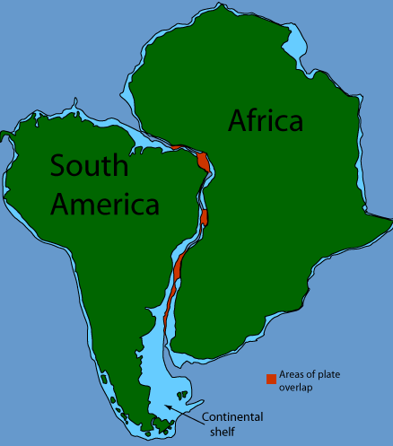
CORRESPONDING ROCK STRATA

Slide 20
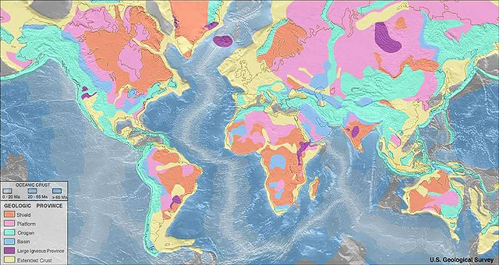

Slide 21
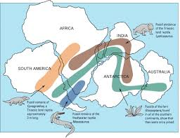
Fossil Evidence

Slide 22
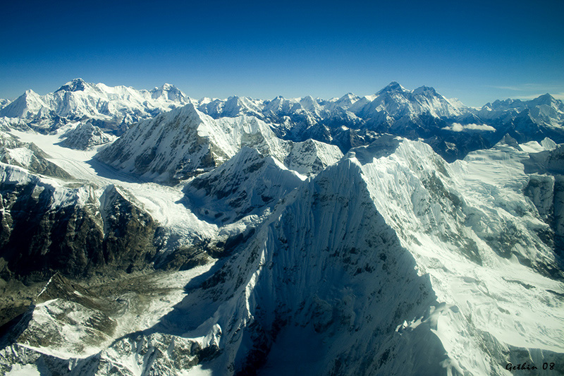
Direct Measurement of Plate Movement

Slide 23
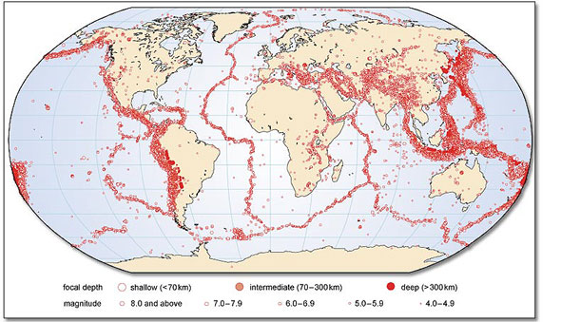
Seismic activity

Slide 24
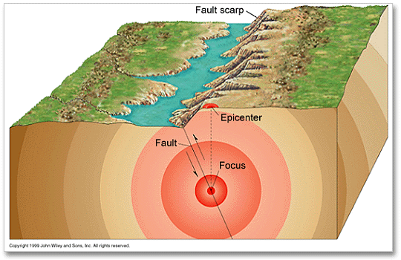
Earthquake Foci

Slide 25
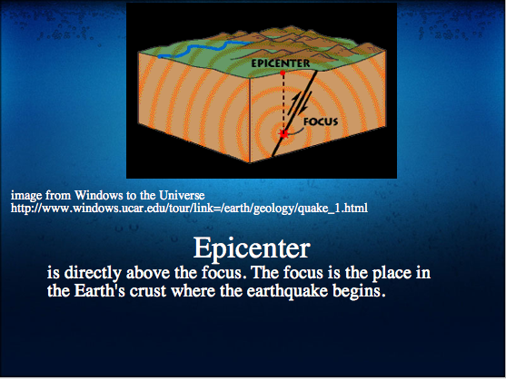

Slide 26
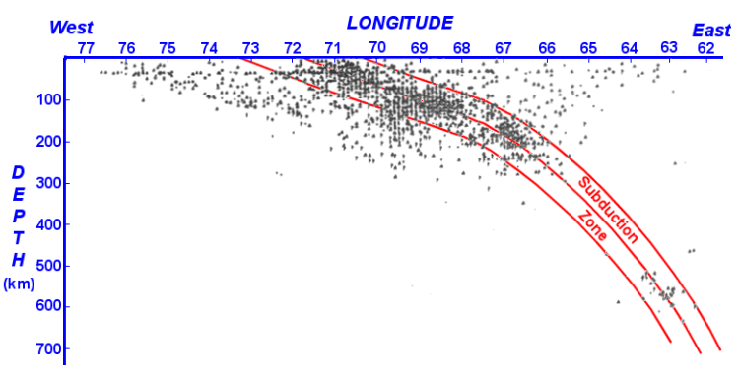

Slide 27
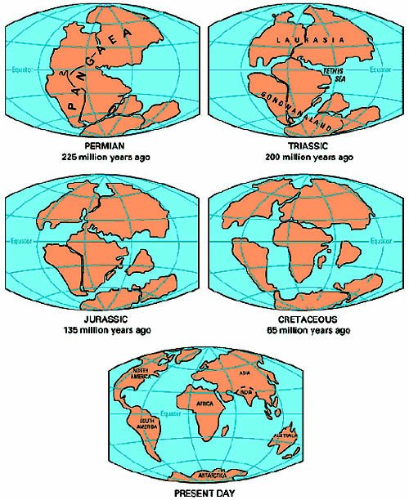
Continent fit

Slide 28
Pangaea

Slide 30
  theory : A hypothesis that survives repeated challenges and is supported by accumulating favorable evidence.

Slide 32
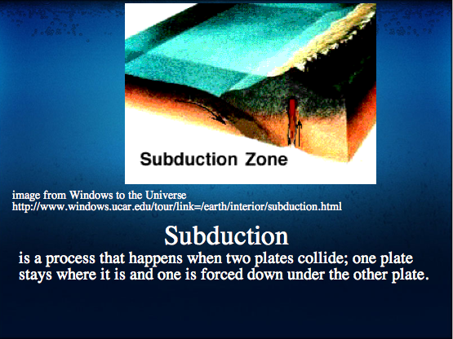

Slide 33
