Slide 1
WELCOME
Target
Plate Tectonics

Slide 2
1. What kind of Plate Boundary is this? EXPLAIN.
Mt. St. Helens
Mt. Hood
Molalla

Slide 3
2. Describe what type of plate boundary is this? What landform is created?

Slide 4
3. Explain with some detail, what is happening between these 2 plates.
Euroasian Plate
1
2 Indian
Plate

Slide 5
4. This is a picture of the Aleutian Islands in the Northern Pacific between Asia and Alaska. Discuss some plate activity going on in this area using the distinguishing visible plate boundary feature. Explain the relationship of the visible feature and the Ring of Fire.
NorthAmerican Plate
Euroasian Plate
Pacific Plate

Slide 6
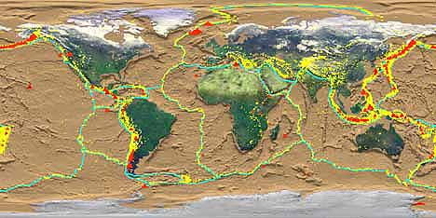
5. Discuss the evidence of plate tectonics this image supports. How?

Slide 7
6. On average how far do plates move per year.
A. 1 foot-2 feet
B. 2 cm -5 cm
*Describe something related to that length
C. 10 feet -50 feet
D. 1 kilometer (.7 miles) to 5 km (3.1 miles)

Slide 8
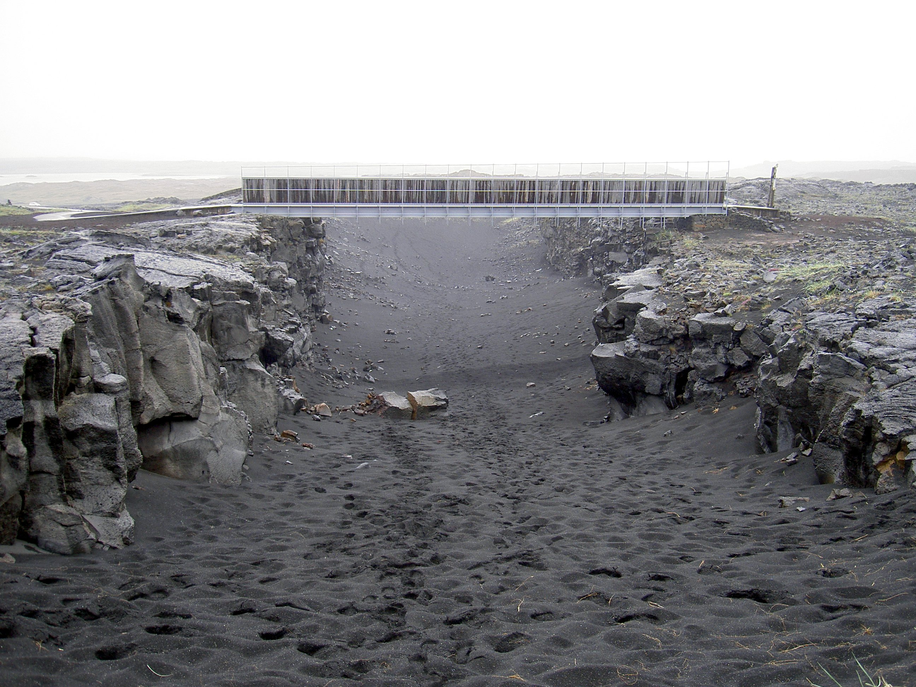
7. What kind of plates and plate boundary? What is happening in the picture? Use technical terminology.

Slide 9
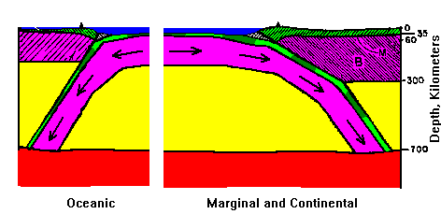
8. Explain the force moving these plates. How do they work? What drives them?

Slide 10
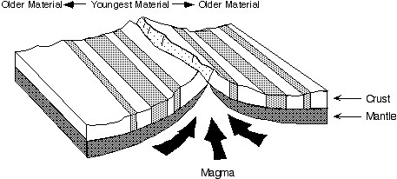
9. This picture represents what type of evidence for Plate Tectonics? Explain the different colored lines. Where we might find the oldest rock? Why?

Slide 11
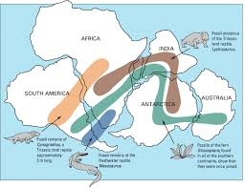
10. Explain how this diagram is supportive evidence of the theory of Plate Tectonics

