Slide 1
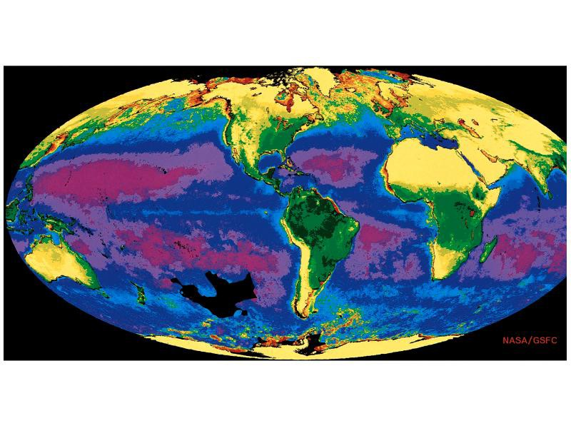
Overview
70.8% of Earth covered by ocean
97.2% of surface water
Interconnected global or world ocean

Slide 2
Principal oceans
Pacific
Largest, deepest
Atlantic
Second largest
Indian
Mainly in Southern Hemisphere

Slide 3
Arctic
Smallest, shallowest, Northern Hemisphere
Antarctic
Connects Pacific, Atlantic, and Indian

Slide 4
Comparison of land and depth
Average depth of ocean 3729 m
Average elevation of land 840 m
Deepest ocean Mariana Trench 11,022 m
Highest mountain Mt. Everest 8850 m

Slide 5
History of Oceanography
1. Principles of Marine Science emerge gradually over time, constrained by
2. religion, sociology, technology.
Polynesian voyages in the Pacific
Arabs/Indians sail the Indian Ocean
Chinese ships explore African coast
Europeans explore the world oceans
3. Motivations: riches, food and war

Slide 6
Why do we speak languages from Europe?
Indigenous people lived here right?
The Chinese had huge ships with lots of supplies right?
The Polynesians explored the Pacific first right?

Slide 7
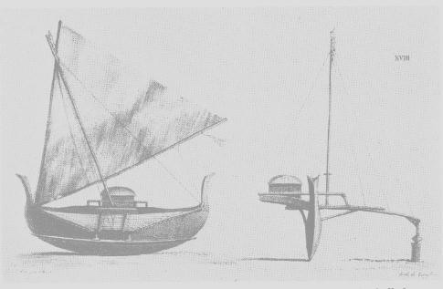
Polynesia: the first voyagers
1. By 2,500 years [BP] almost all Pacific Islands except Hawaii were colonized.
2. Outrigger canoes can tack into wind but narrow hulls hold little cargo and hulls rack in strong seas.
3. Navigated by stars, but no written language, so knowledge of stars was memory dependent.
  Stick charts in some cultures
4. Voyaging limited by number of coconuts/boat. Coconuts supplied food, water and vitamin C.

Slide 8
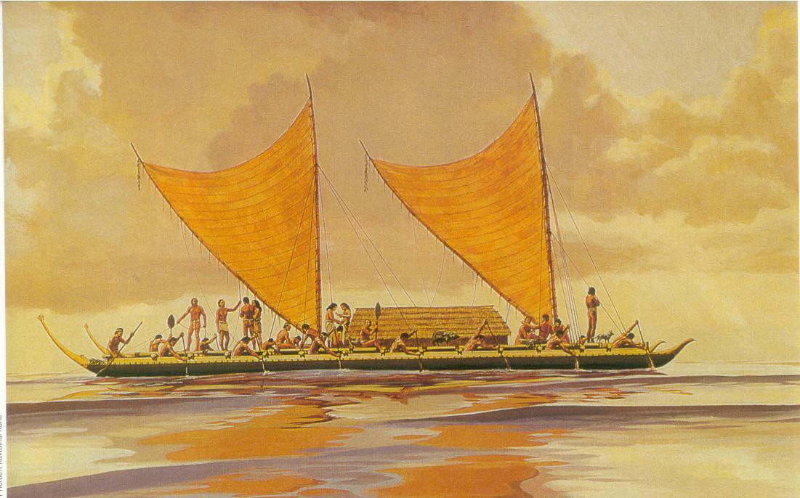
Voyaging Outrigger

Slide 9
Arab/Indian dhows, the Indian Ocean and the seasonal monsoon
1. Large lateen­rigged ships; large cargoes for trading.
2. Shallow draft ships with huge center boards don’t tack well, but fast down­wind.
3. Monsoon winds in Indian Ocean blow from east for 6 months and from west for 6 months.
4. Indian Dhows into South Atlantic, probably to South America, in 1420.

Slide 10
Chinese ocean voyaging
1. Chinese junks have full battened sails; tack easily into the wind.
2. Big hulls, large holds, lots of water, good provisions.
3. From 1417­1433 Chinese built super­ junks, up to 440 ft long for coastal trade (no navigation).
4. Chinese invented the Compass!
4. Found no new markets; Admiral Cheng Ho was beheaded; ships were burned.

Slide 11
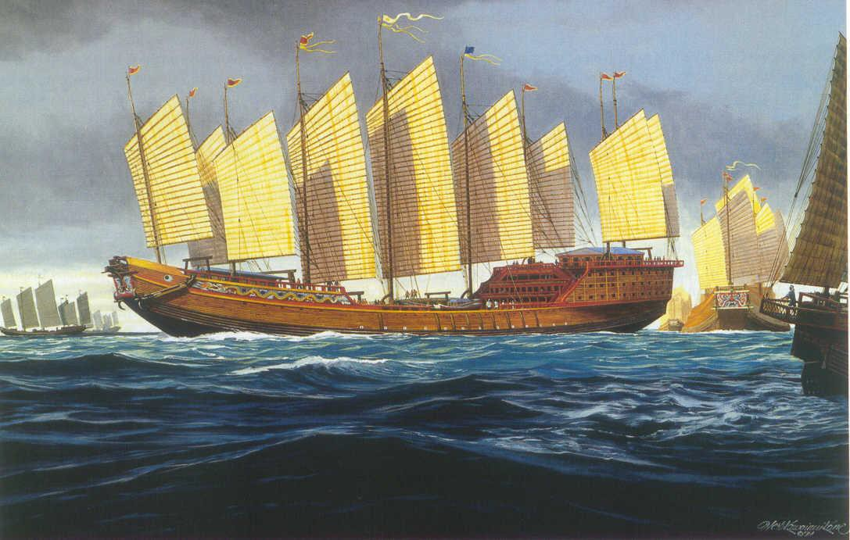

Slide 12
European voyaging
1. Belief in a flat earth constrained exploration.
2. Square­rigged ships have big hulls with large cargoes, but only sail down wind.
3. Navigation: sextant gives azimuth of sun for latitude, but longitude was measured by dead­reckoning because
4. pendulum clocks won’t work on a rolling ship . Needed new clocks.
5. No coconuts! Scurvy kills after few months of no vitamin C (ascorbic acid).

Slide 13
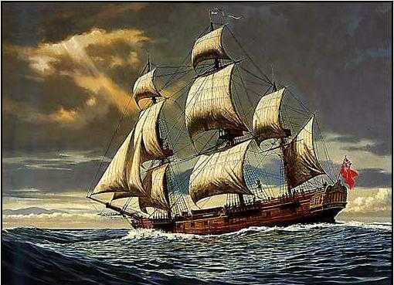
HMS Resolution

Slide 14
Who wins the exploration sweepstakes?
1. Polynesians?
 No. No written language; limited cargo space constrained warfare and trade.
2. Arabs?
 No. Only one east­west trade route.
3. Chinese?
 No. Rigid autocracy not healthy for ambitious Admirals.
4. Europeans?
Yes!!! Boat design was dumb but big. Discovered clocks and limes, then raped and pillaged new world with Guns, Germs, and Steel in the “Discovery” of the new world.

Slide 15
Motives for European Exploration: food, riches, war
1. New lands: Norse explorations (@1000) but native Americans were too feisty.
2. New fish stocks: Basques fished for cod off Newfoundland (@ 1200 AD), but no one told!
3. Spices and gold: Columbus (1492) sails down­ wind via trades to Caribbean. Spanish begin to plunder new world. Magellan sails down­wind around the world (1522), and Spanish pillage Philippines for 250 years.
4. Exploration: British (1768) send Captain James Cook with Harrison’s chronometers on 3
round­the­world voyages…all cruises down­wind.

Slide 16
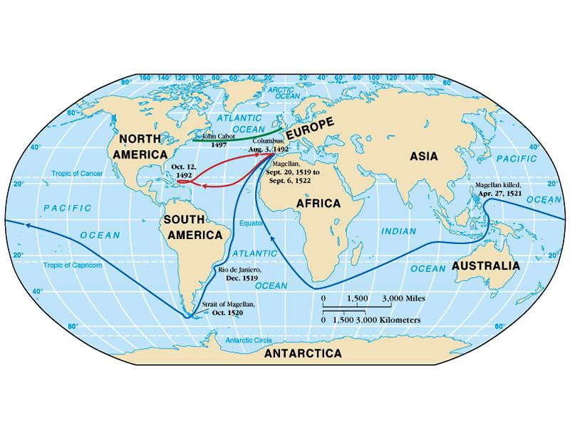
Columbus, Magellan, Cabot

Slide 17
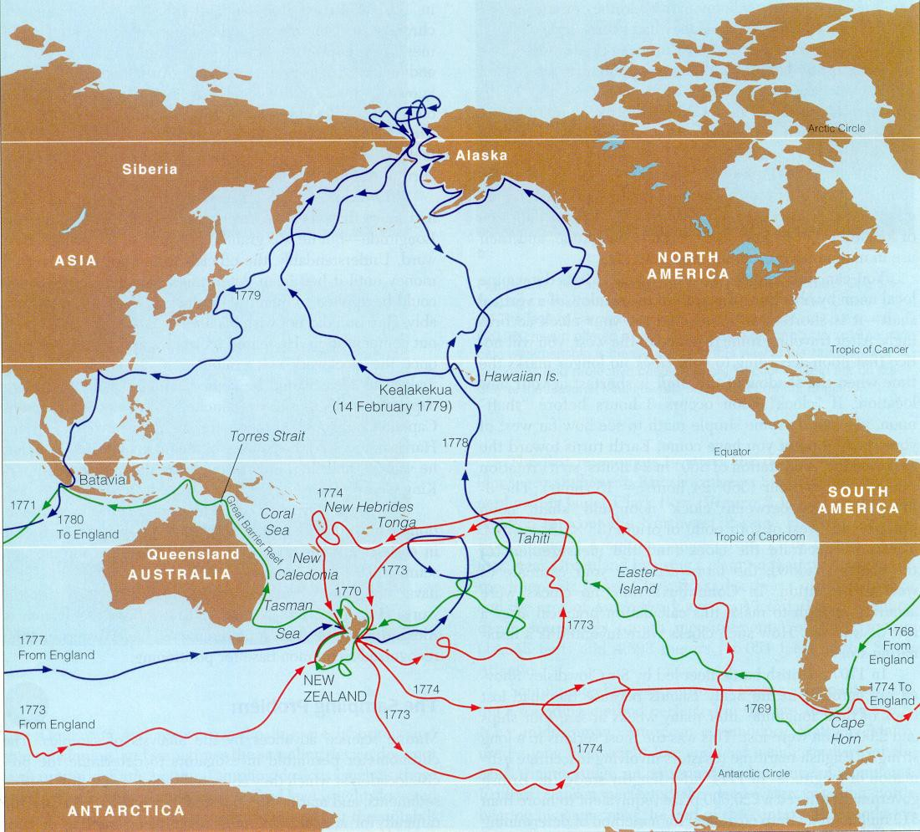
Ship track of Cook’s voyages (1768­1780)

Slide 18
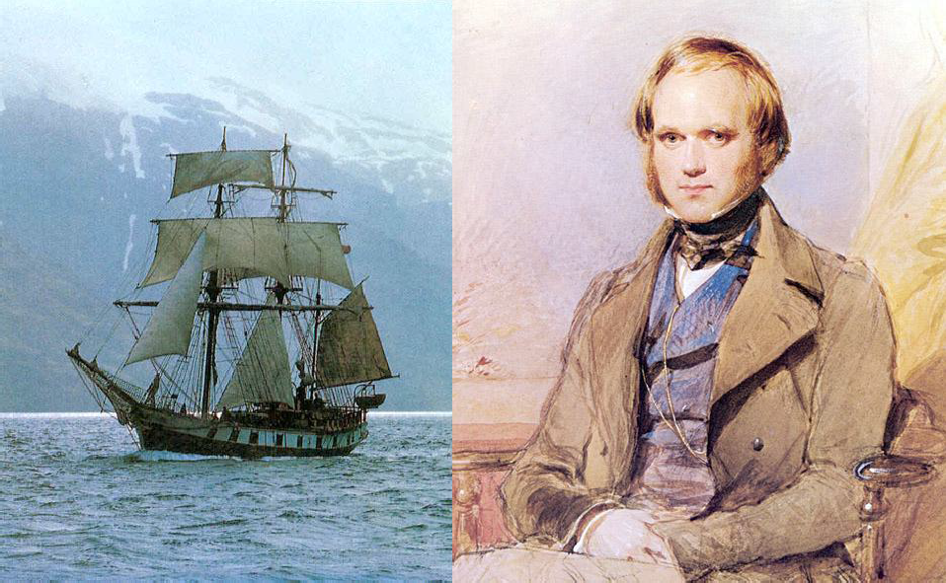
Darwin and the Voyage of the Beagle (1831­36)

Slide 19
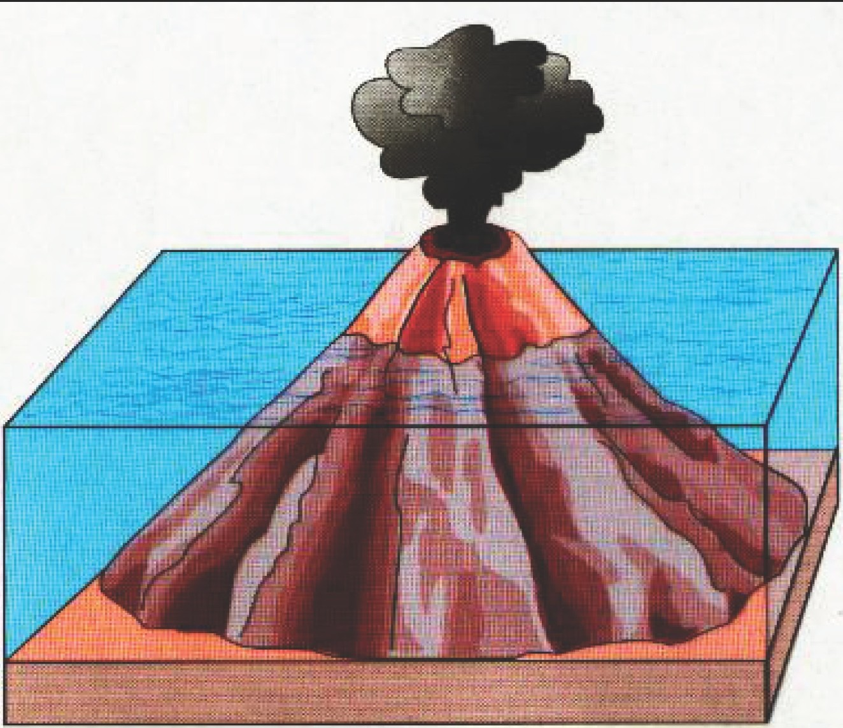
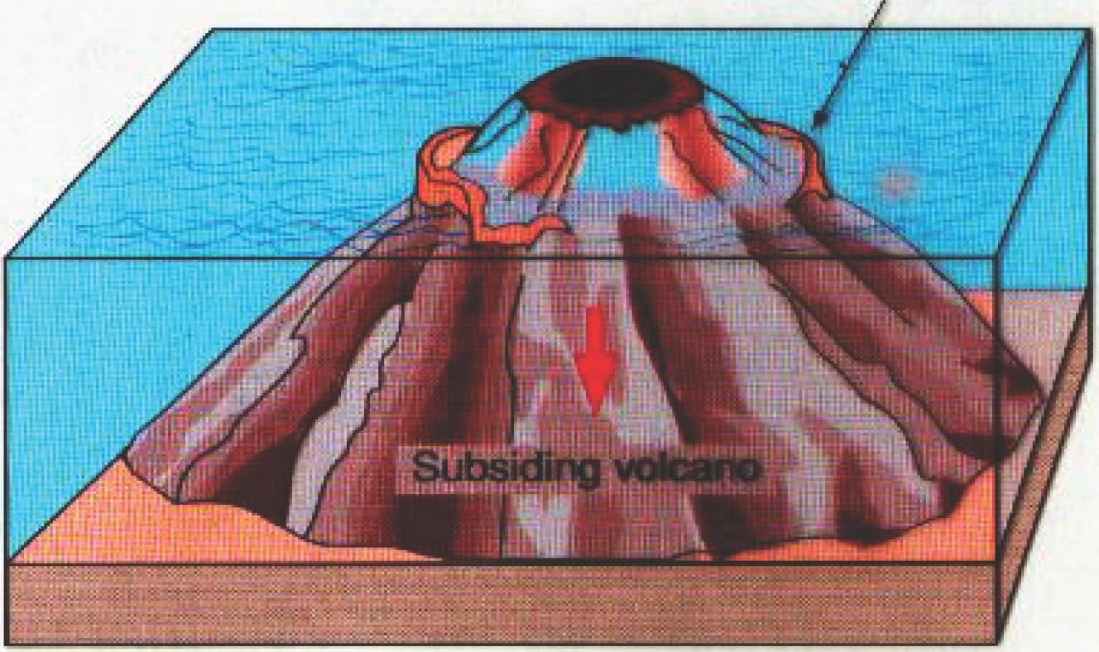
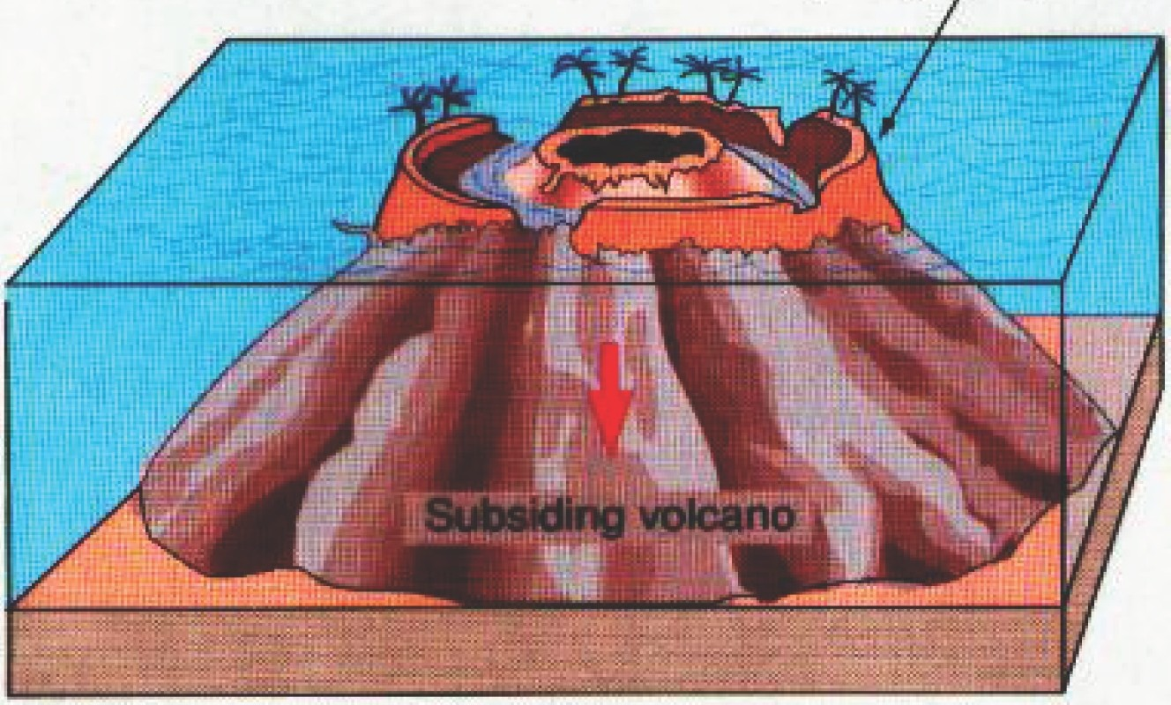
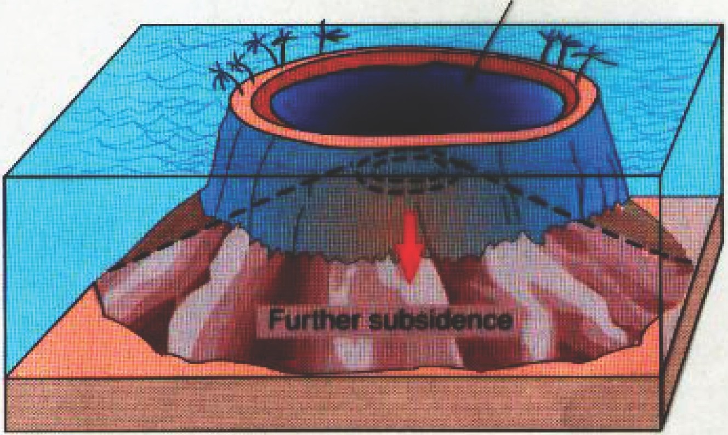
Coral reels on side ot lAllcano,
a Active volcano
b· Fringing reef
Reefs grow upward
lagoon
c Banier reef
d Atoll

Slide 20
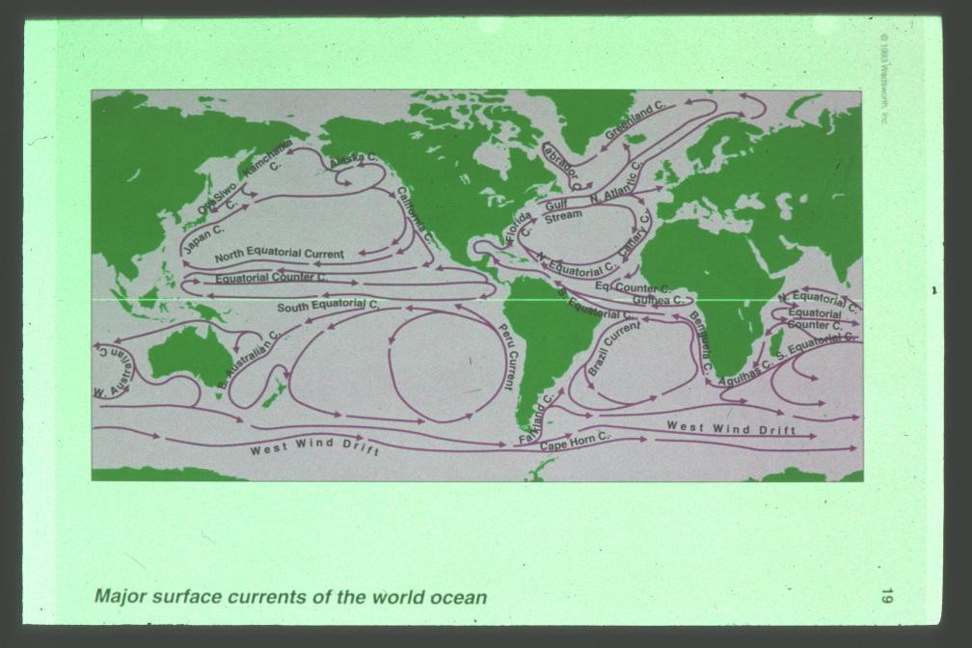
Matthew Maury (1885)

Slide 21
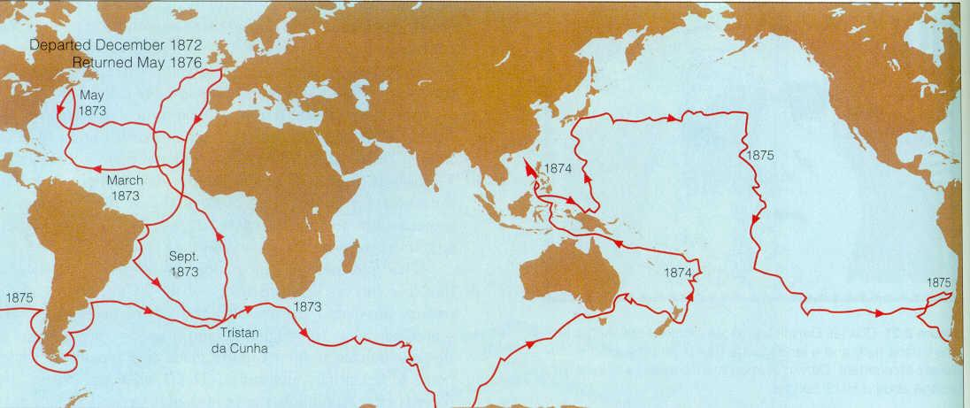
Voyage of the Challenger (1872­75)

Slide 22
First Marine Laboratories
1872 Statione Zoologica (Naples)
1888 Woods Hole
1892 Hopkins Marine Station
1905 Scripps

Slide 23
Significant discoveries and dates in oceanography
1. Alfred Wegner poses continental drift in 1912.
2. William Beebe and Otis Barton build Bathysphere in 1928; dive off Bermuda. “Half­mile Down” 1934
3. World War II boosts submarine design and construction. Echo soundings used by military to map Atlantic and Pacific Oceans. Deep­scattering layer.
4. Jacques Cousteau and Emile Gagnan invent the aqualung 1943.
5. Plate tectonics re­discovered 1960’s.
6. SeaSat 1978; First ocean­observing satellite.

Slide 24
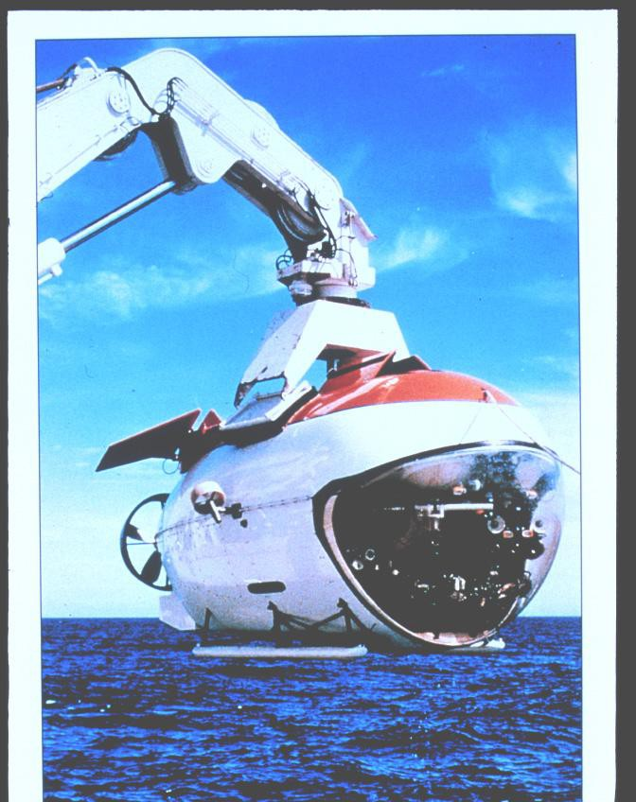
Russian submersible “Mir”

Slide 25
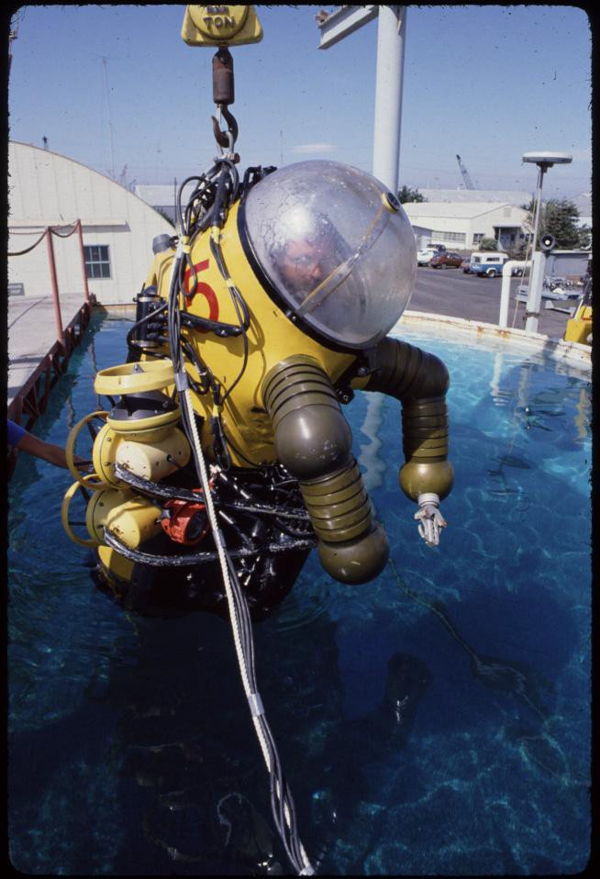
Wasp submersible

Slide 26
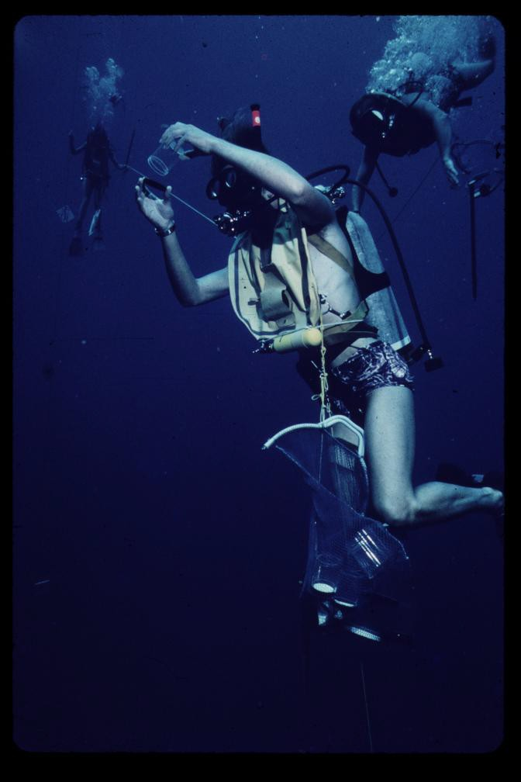
Diving in blue water

Slide 27
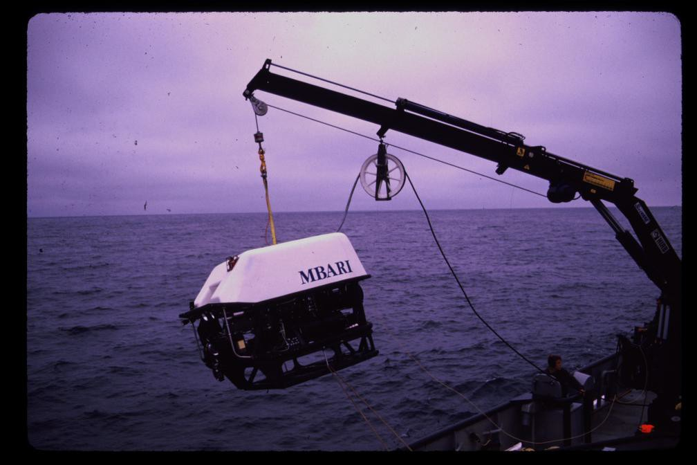
ROV Ventana

Slide 28
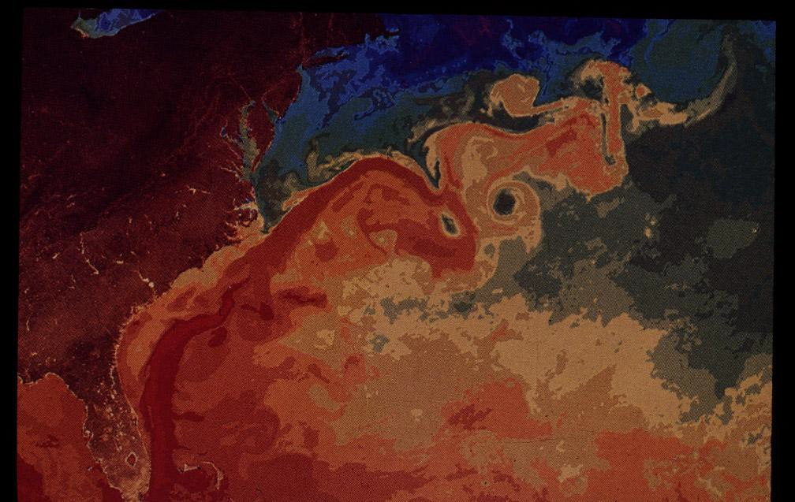
SeaSatellite view of Gulf stream: warm core and cold core rings

